Slide 1
InFood
Hasa Reddy
Capstone 2022
Notes:
Morning everyone!
I am Hasa, and I am here to my proposal for an initiative to tackle food insecurity while proving supporting infrastructure to further digital inclusively in the City of Philadelphia.

Slide 2
Identifying the required food and internet network locations to help underserved communities of Philadelphia potentially facing food insecurity and digital divide.
TOPIC
Notes:
Morning everyone!
I am Hasa, and I am here to my proposal for an initiative to tackle food insecurity while proving supporting infrastructure to further digital inclusively in the City of Philadelphia.

Slide 3
Literature review
Users
Data
Analysis
Next steps
CONTENTS
Notes:
Morning everyone!
I am Hasa, and I am here to my proposal for an initiative to tackle food insecurity while proving supporting infrastructure to further digital inclusively in the City of Philadelphia.

Slide 4
Food insecurity is defined as the disruption of food intake or eating patterns because of lack of money and other resources.
The term "digital divide" refers to the gap between individuals, households, businesses and geographic areas at different socio-economic levels with regard to both their opportunities to access information and communication technologies (ICTs) and to their use of the Internet for a wide variety of activities.
Digital literacy refers to an individual's ability to find, evaluate, and clearly communicate information through typing and other media on various digital platforms. It is evaluated by an individual's grammar, composition, typing skills and ability to produce text, images, audio and designs using technology.
Food insecurity based on FAO
FOOD INSECURITY
DIGITAL LITERACY
Uncertainty regarding ability to obtain food
Compromising on food quality and variety
Reducing food quantity, skipping meals
No food for a day or more
Food Security to Mild Food Insecurity
Moderate Food Insecurity
Severe
Food Insecurity
Notes:
Food insecurity, affected 10.5 percent of all U.S. households in 2020, unchanged from 2019. Households with children, however, experienced statistically significant increases in food insecurity during the Coronavirus (COVID-19) pandemic, even as overall food insecurity stayed the same. In 2020, 85.2 percent of households with children were food secure, while 14.8 percent were food-insecure, up from 13.6 percent in 2019.
But the Federal Communications Commission estimates that more than 21 million people in the United States don’t have that connection. That includes nearly 3 in 10 people—27 percent—who live in such rural places as the outreaches of Maine and the fertile fields of Indiana, as well as 2 percent of those living in cities.
Research shows that 40 percent of schools lack broadband, as do 60 percent of health care facilities outside metropolitan areas.

Slide 5
CONCEPT
“Don’t let the digital divide become ‘the new face of inequality’: UN”
The digital divide depends on five factors that determine the level of equality of access to information technology systems:
The existence of physical infrastructure for transmission;
The availability of connection equipment such as a computer, modem, and access line;
Training in the use of the computers and the Internet;
Intellectual capacities and the social insertion of users
The production and use of specific contents adapted to the needs of the diverse segments of the population.
Philadelphia
Food insecurity 21%
17% of trash sent to the landfill is wasted food
Unemployment rate 7.7% (2020)
Conceptually on a neighbourhood scale
Notes:
Food is one the basic necessities as human being and access to internet is one of those basic requirements to survive in the current day and age. In Philadelphia, food insecurity levels rose to 28.6% in 2021 from 24% in 2018.
One hand we have this huge population that needs food and one the other we witness food going to waste at supermarket, restaurants, cafes etc. according to the Philly government nearly 17% of trash sent to the landfill is wasted food. To effective link the supply to demand, and to identify the communities and neighbourhoods that are in dire need, we would be using data collection and machine learning algorithms, the workflow of this and the methodology. Along with food distribution we will also be establishing a network of hotspots through the city at these locations. Which would further be explained by Shaun in the further along.

Slide 6
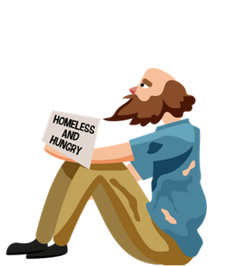

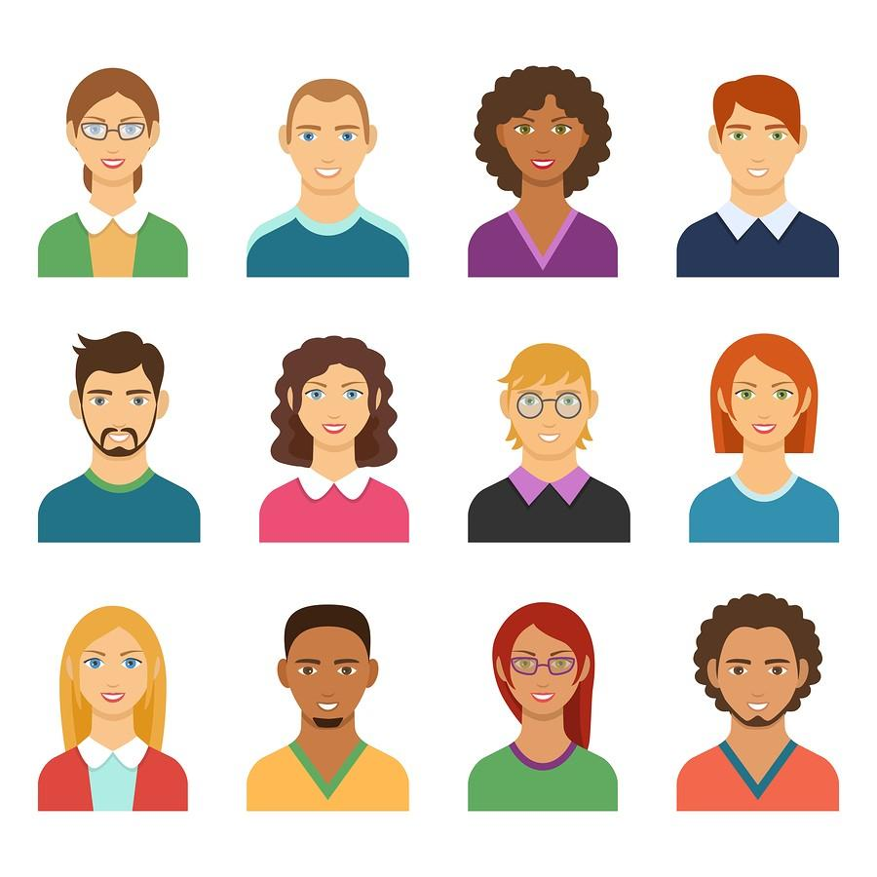


USERS
ERIK
Age: 41yrs.
Education:
Highschool
Background
Homeless
Needs
Meals regularly
and govt programs for the homeless
Suzan
Age: 69 yrs.
Education
School dropout
Background
Living alone
Needs:
Community
engagement
MAX
Age: 13 yrs.
Education
8th Grade
Background
Household with no consistent income
Needs
Wholesome meals
Miriam
Age: 39 yrs.
Education
Grad
Background
Income < $20000 and single mother
Needs
Internet to look up govt. programs & meals for 2
Trey
Age: 23 yrs.
Education
Attending community college
Background
Doing part time jobs and studying
Needs
Access to internet to apply to jobs
Household of 4
Mother, Father
And 2 kids in K-12
Background:
Household income < $30000, one of the parent lost job recently
Needs:
Regularly meals
Internet to apply
for jobs
Notes:
Keeping in mind the target users, communities prone to food insecurity and digital inequality, I have identified few of the user types.

Slide 7



DATA
Parking
Church
Infrastructure
Where needs more Internet coverage
Census
Where to send
Food Supply Resources
Where and When to collect the food
Wi-Fi
Library
Wi-Fi Resources
Restaurant
Food Supply Resources
Univ. dining
…
Census Data
Poverty
Unemployment
Population
Food stamps
Notes:
In the first step, three main types datasets will be collected. The first one is Wi-Fi Resources Datasets. That will tell us where the existing internet is. And how is the condition.
The second one is Food Supply Resources Datasets. This dataset mainly comes from supermarket, cafeteria, food hubs etc etc. It will tell us where and when to collect the food.
The third one is Census Datasets, it will give us demography data and let us know the information about the community and where to send the food and internet.

Slide 8
ANALYSIS

Slide 9
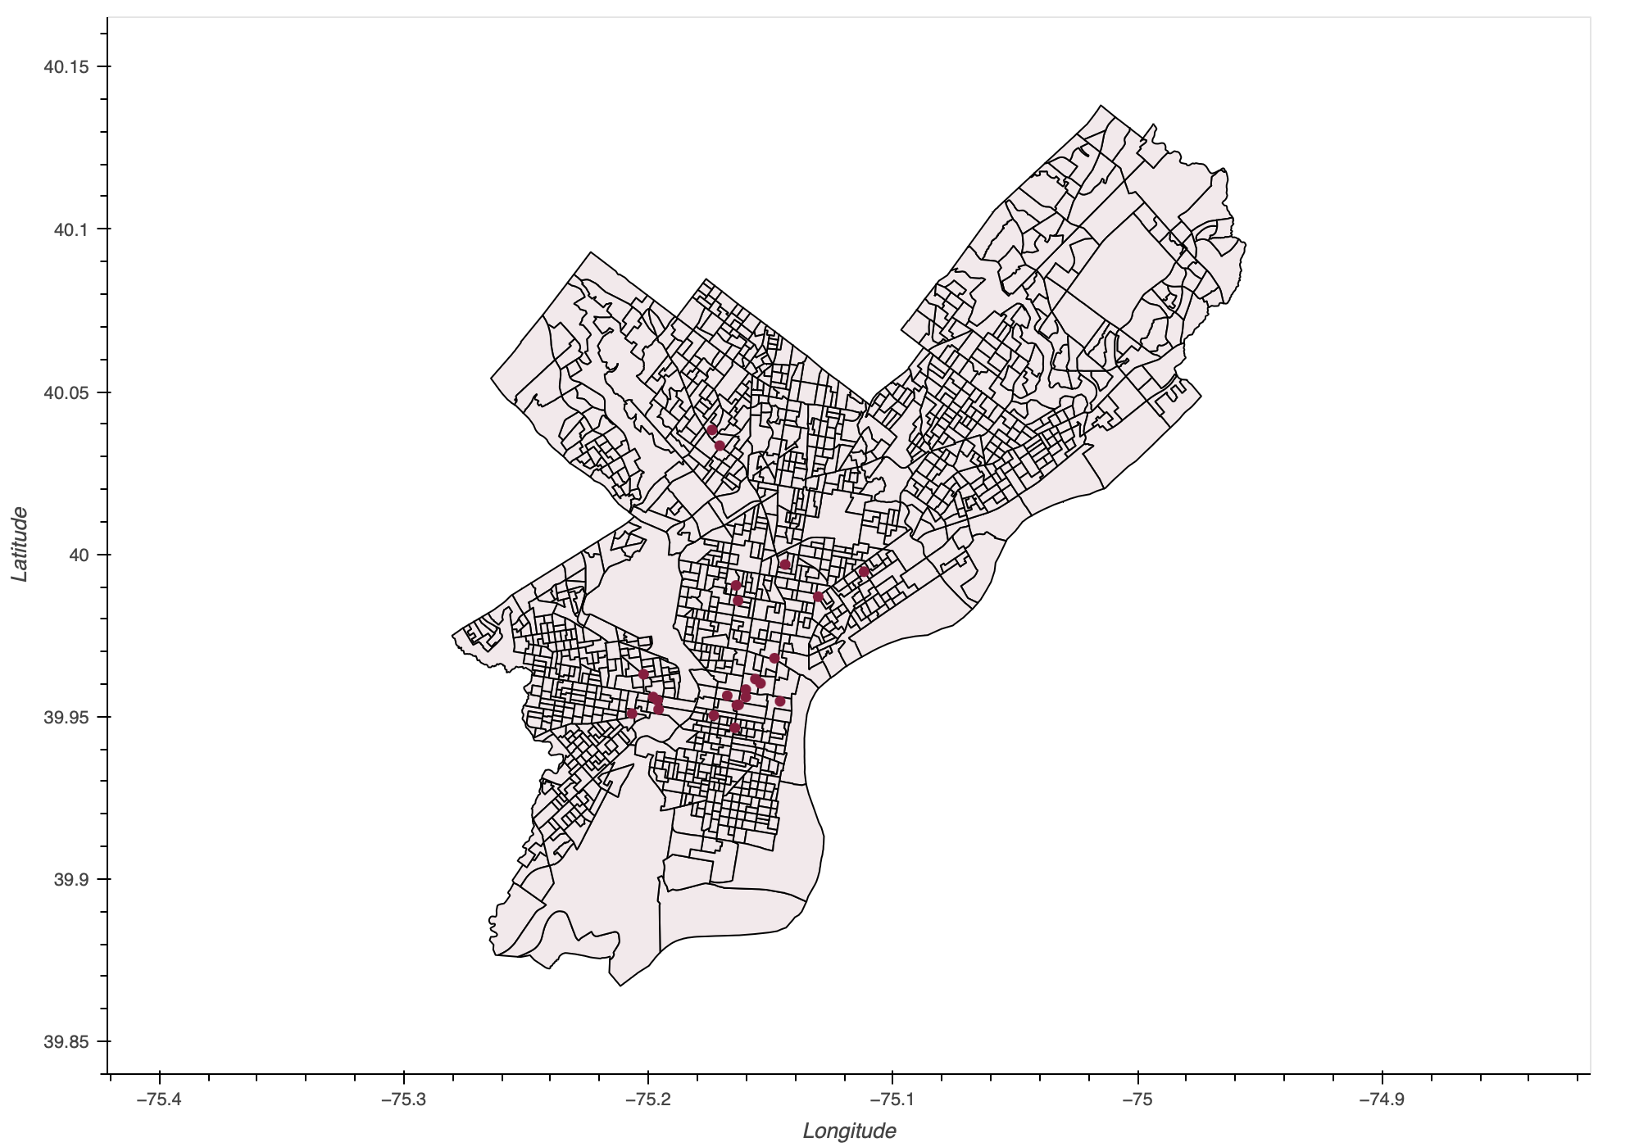
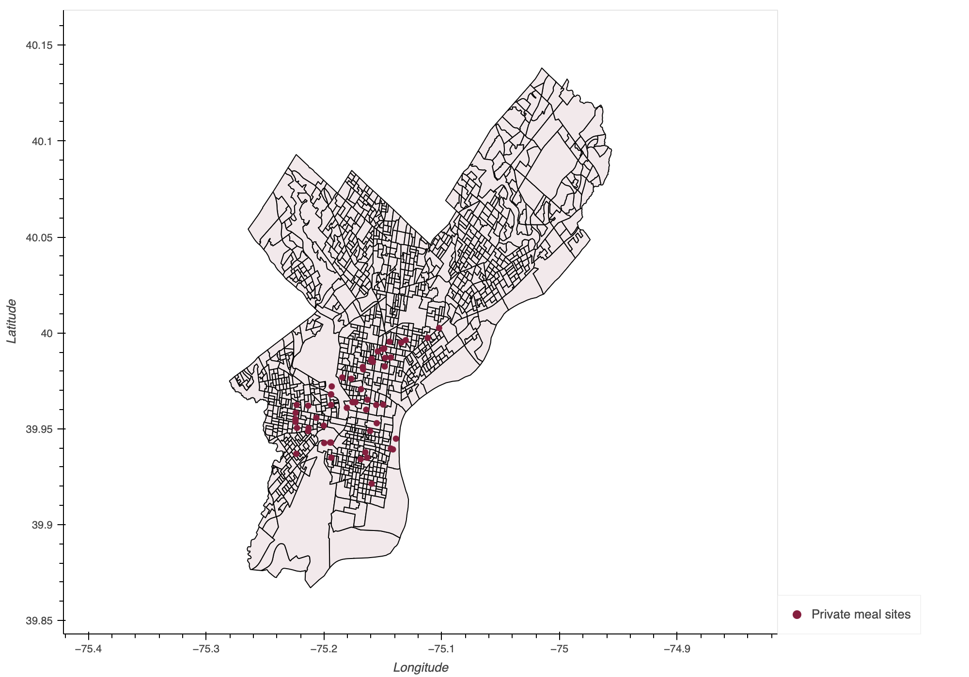
EXISITNG MEAL SITES
The City and its partners provide free food and meals to supplement the existing food pantry network.
Student meal sites provide free meals for children and youth.
Senior meal sites offer grab-and-go meals for older adults.
Meal sites for residents experiencing hunger and homelessness.
City meal sites

Slide 10
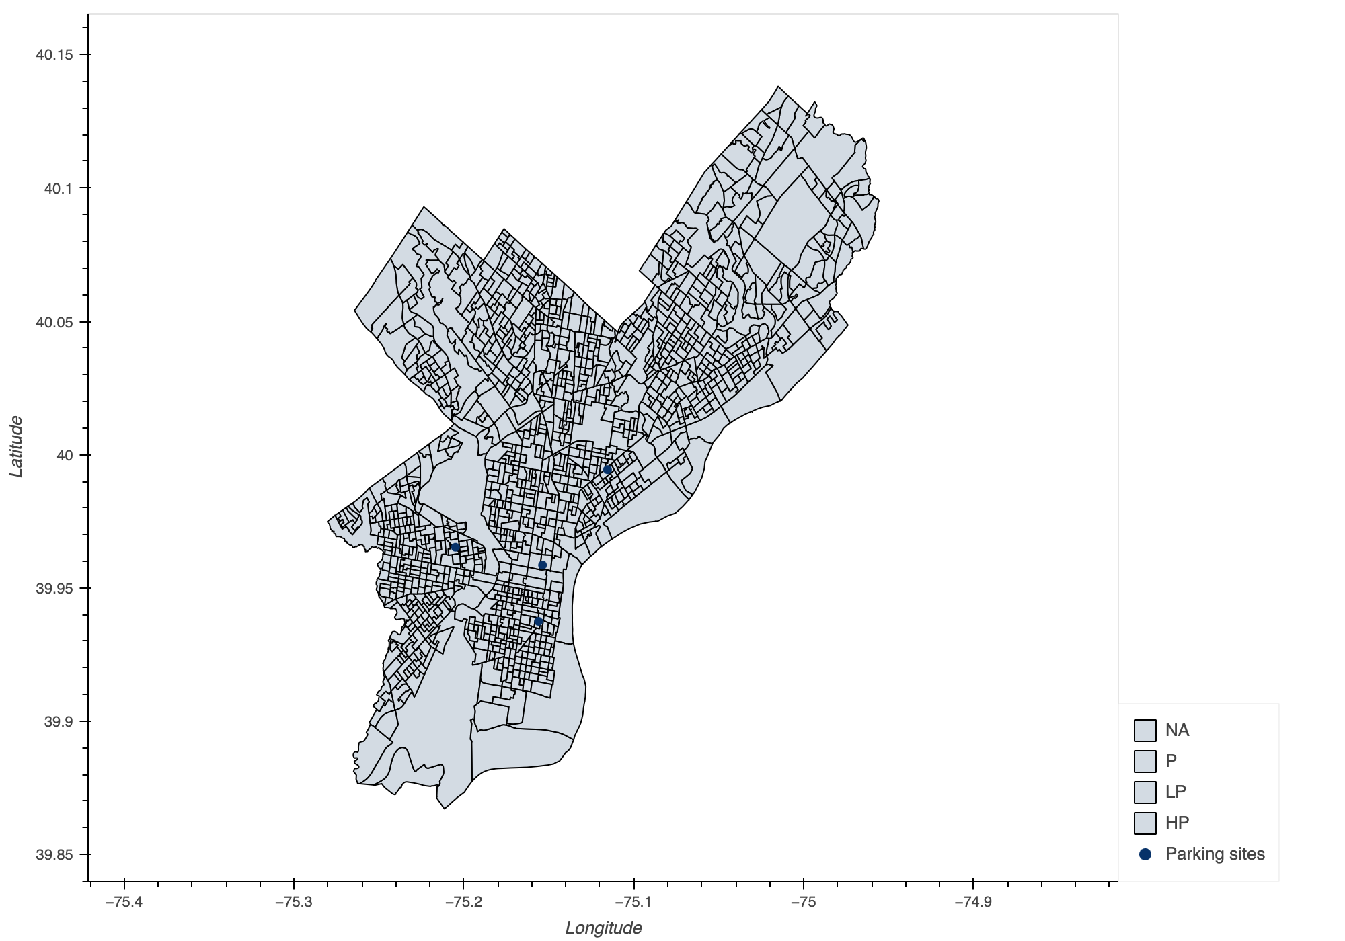
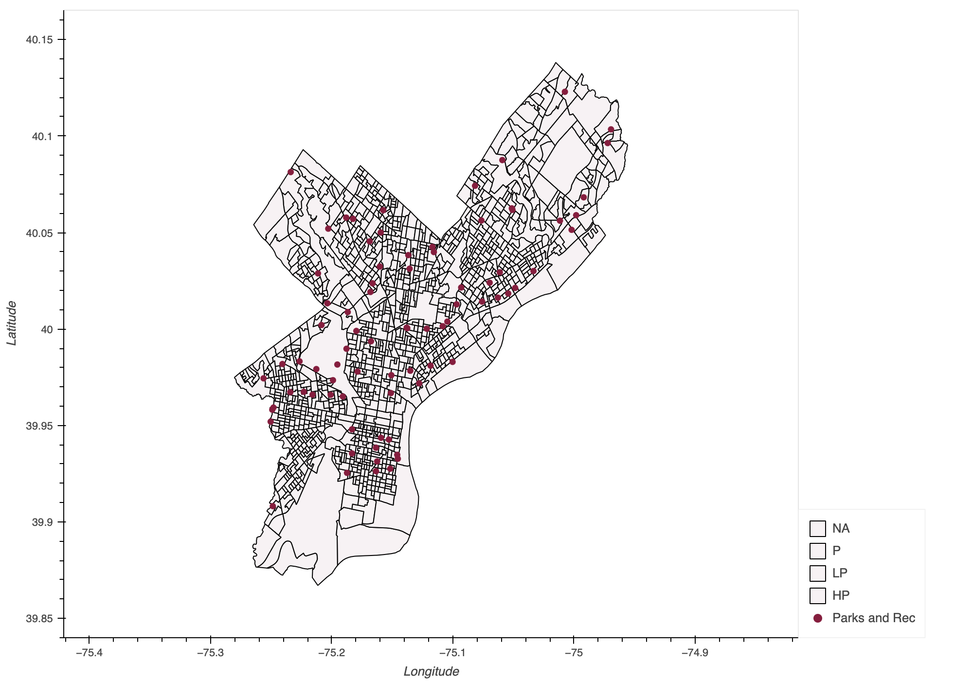
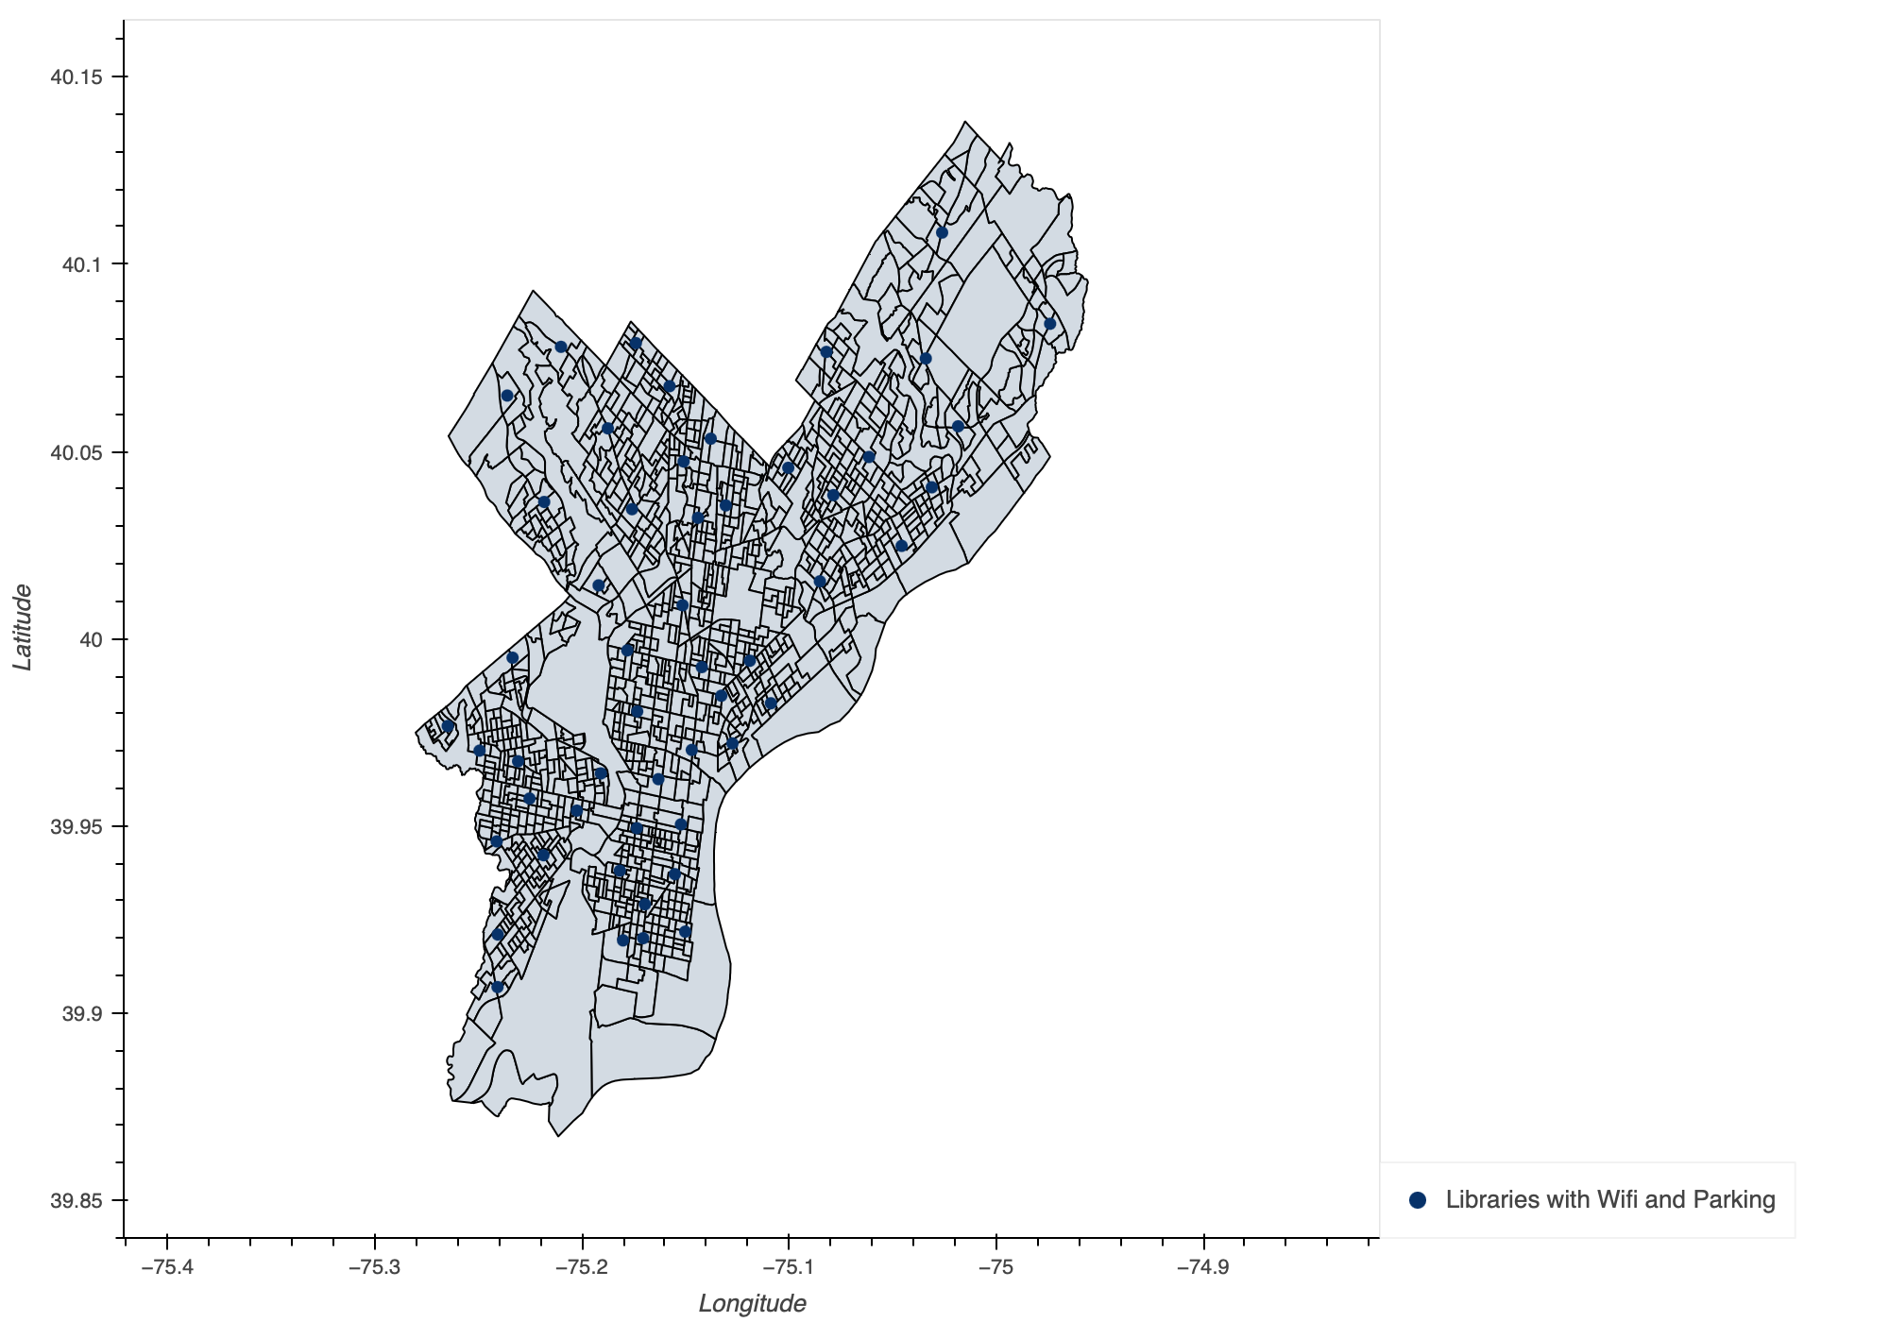
INFRASTRUCTURE
Parking
Parks and rec (with buildings)
Libraries with parking and Wi-Fi

Slide 11
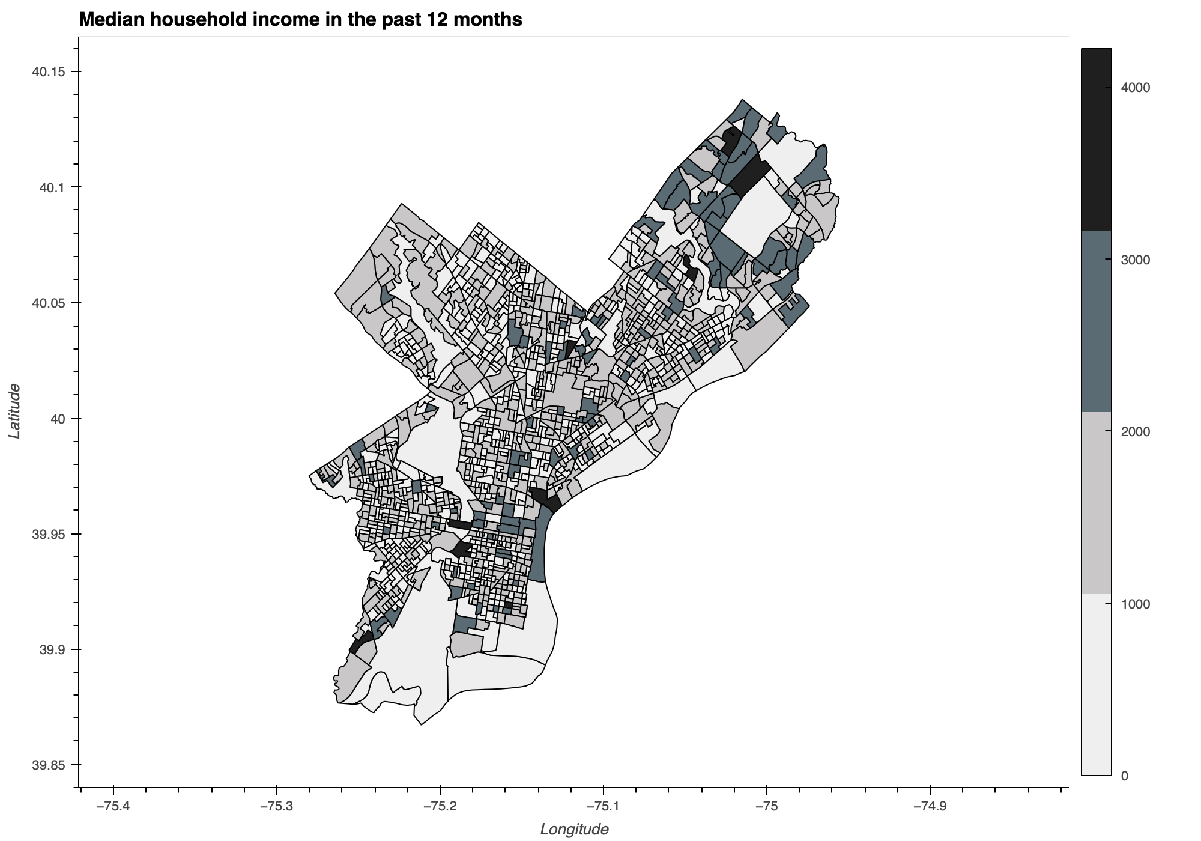
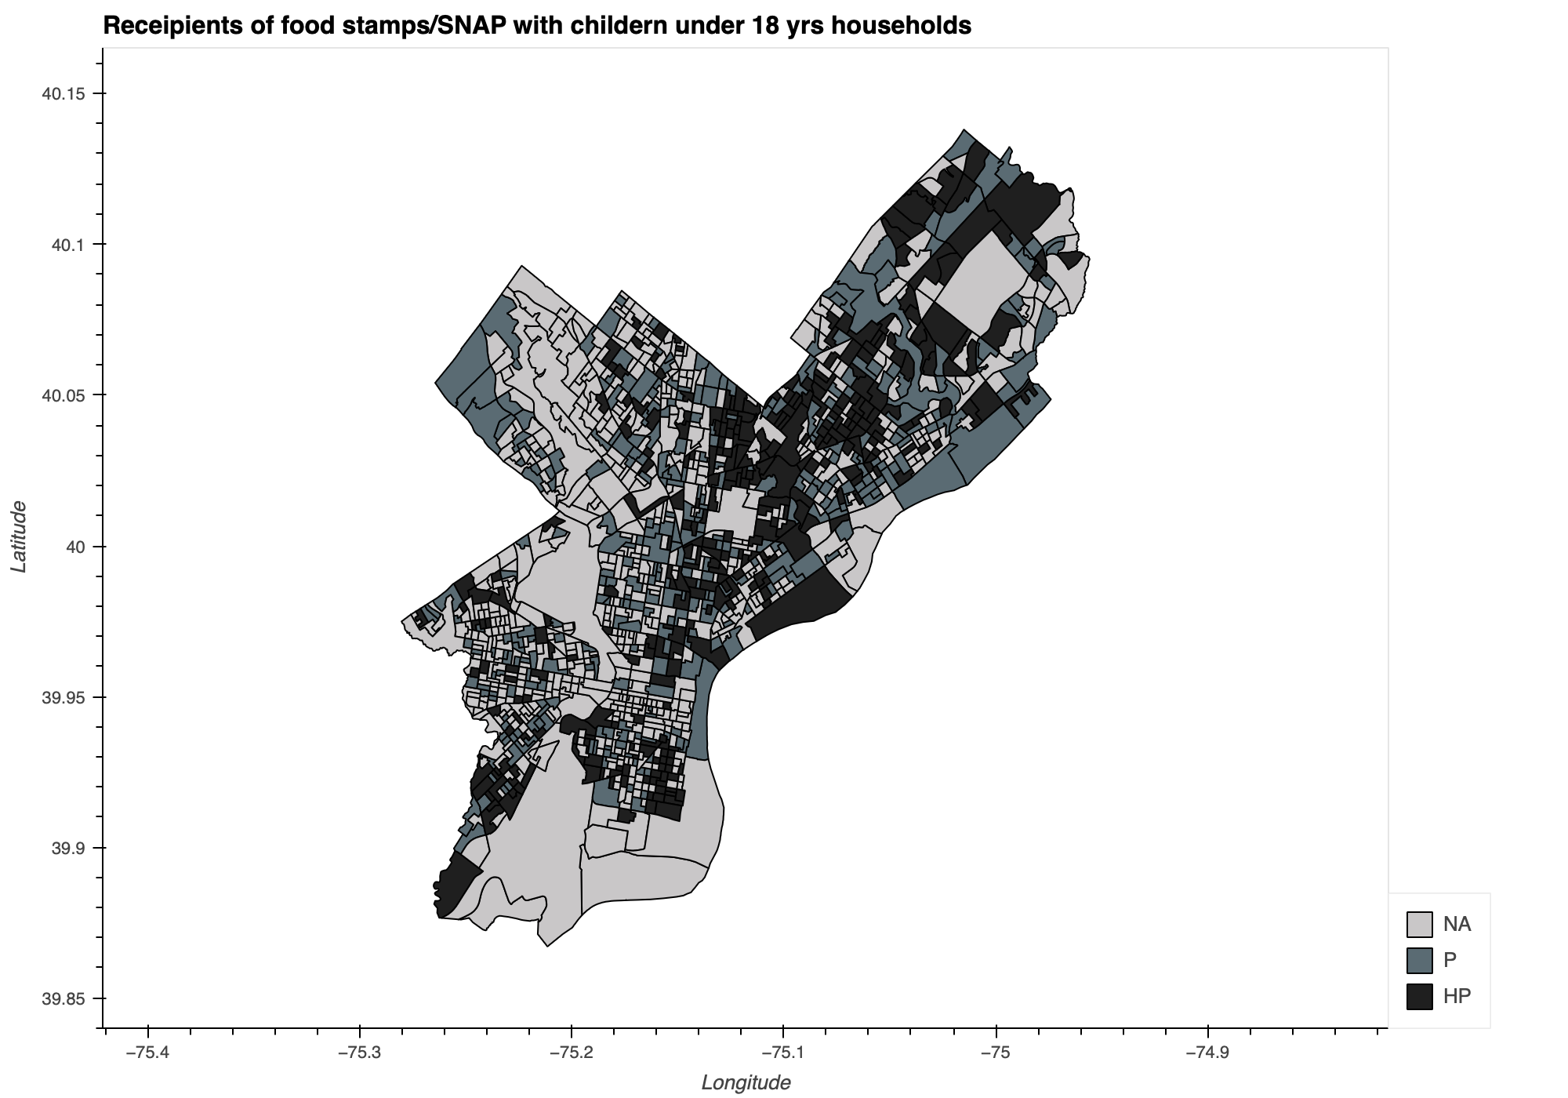
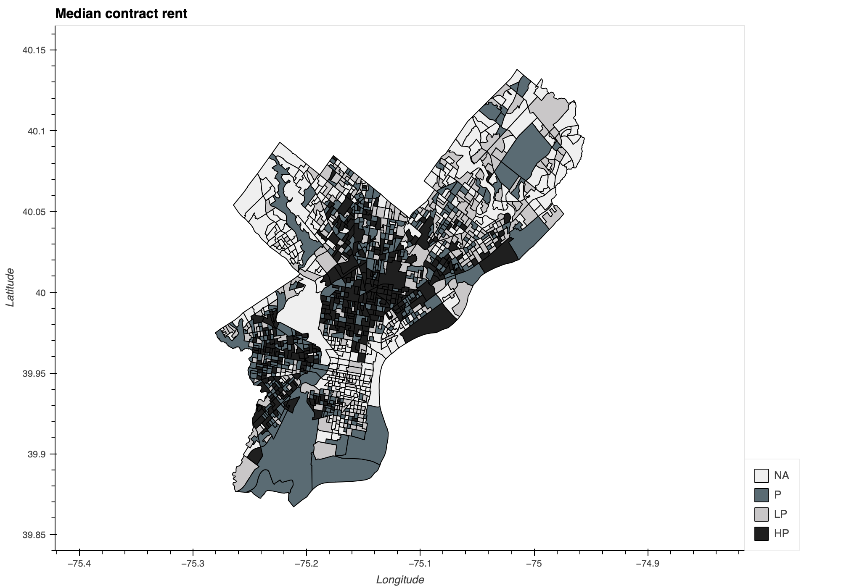
CENSUS
Median household income
Food stamp recipients
Median rent

Slide 12
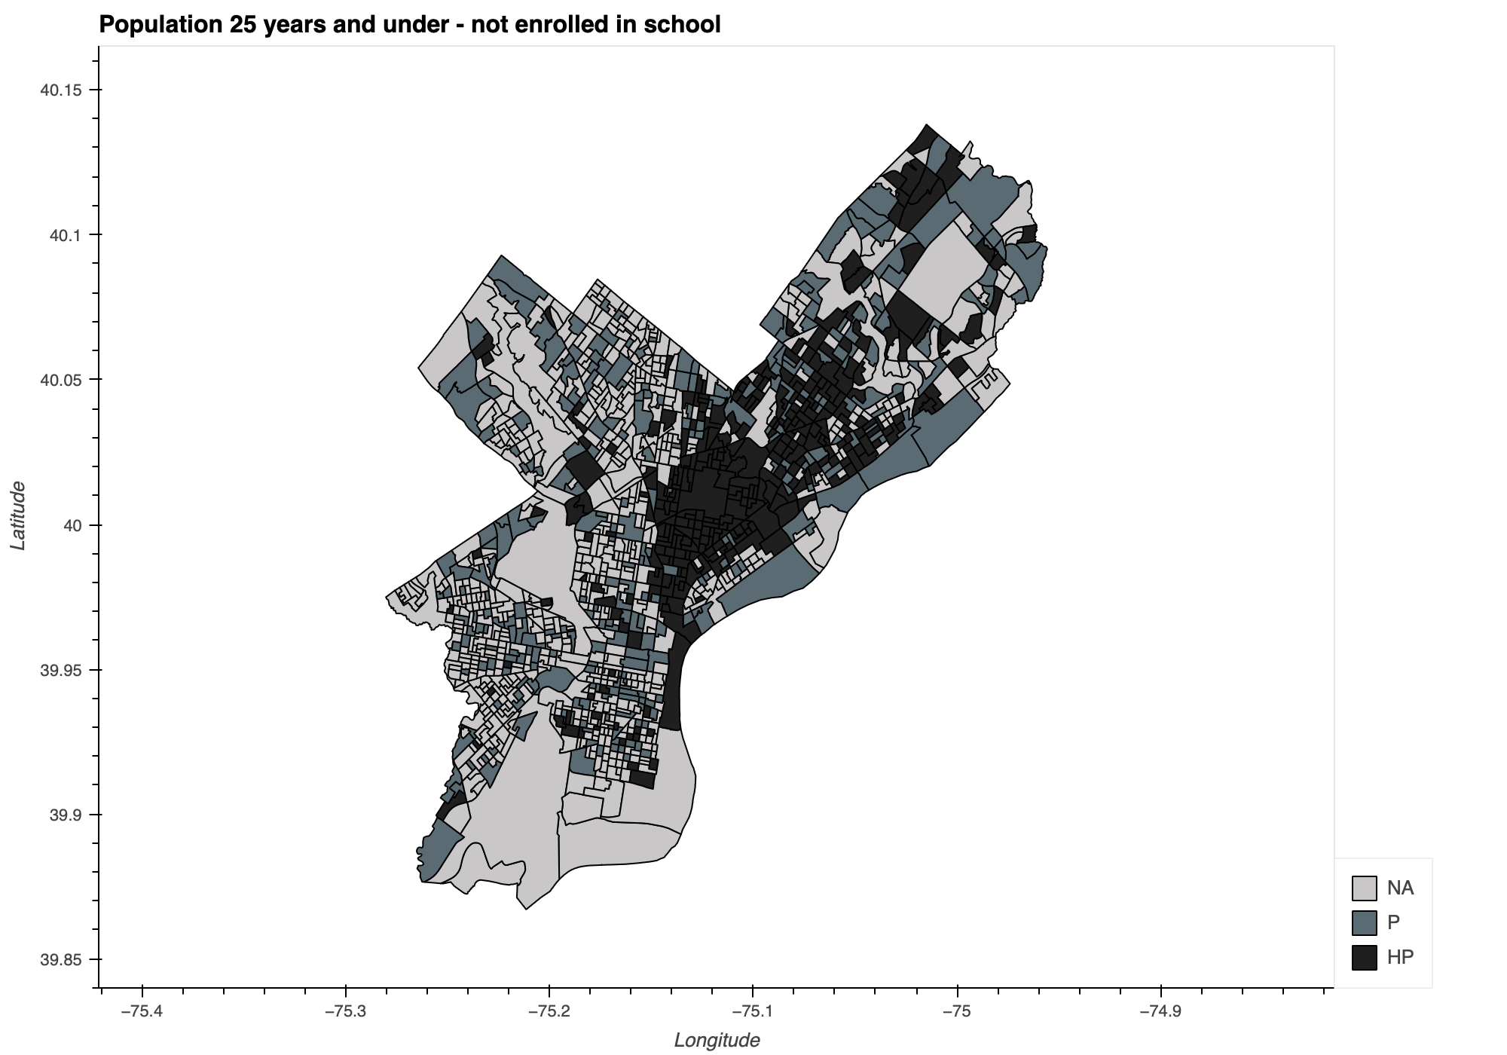
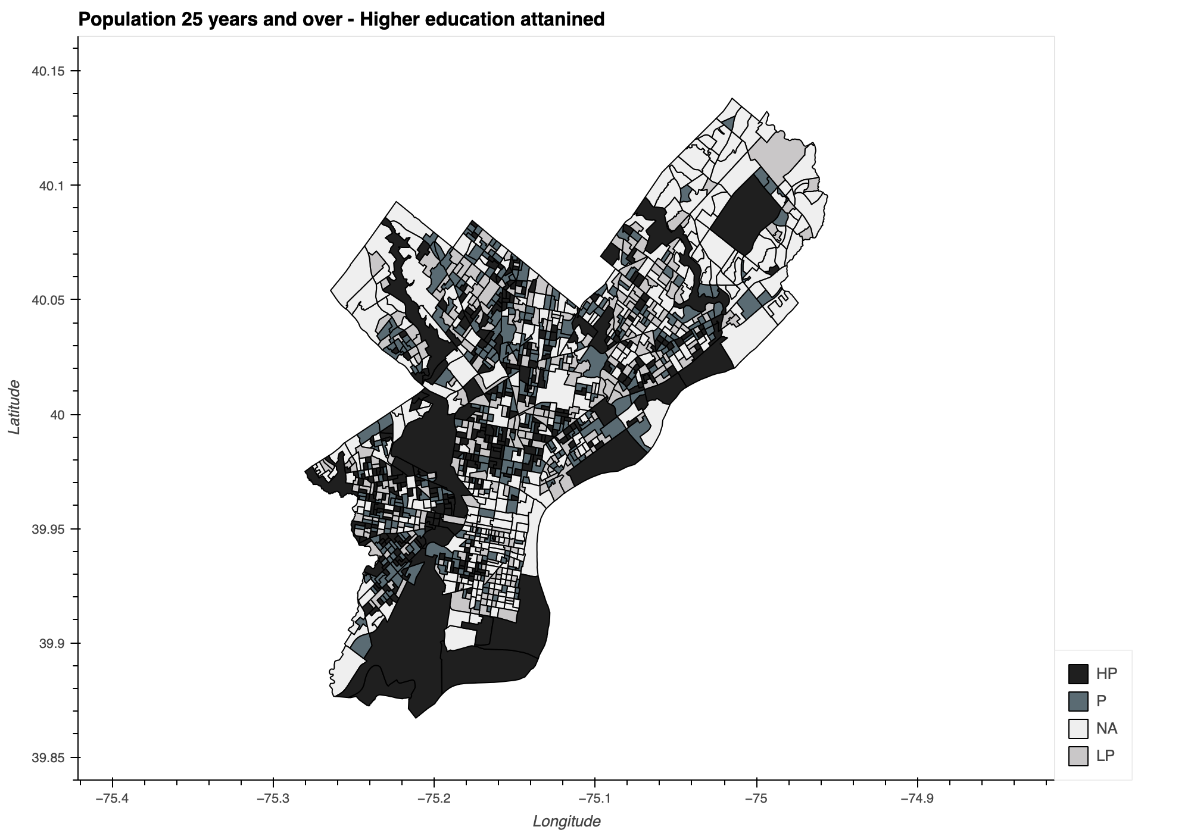
EDUCATION ATTAINMENT

Slide 13
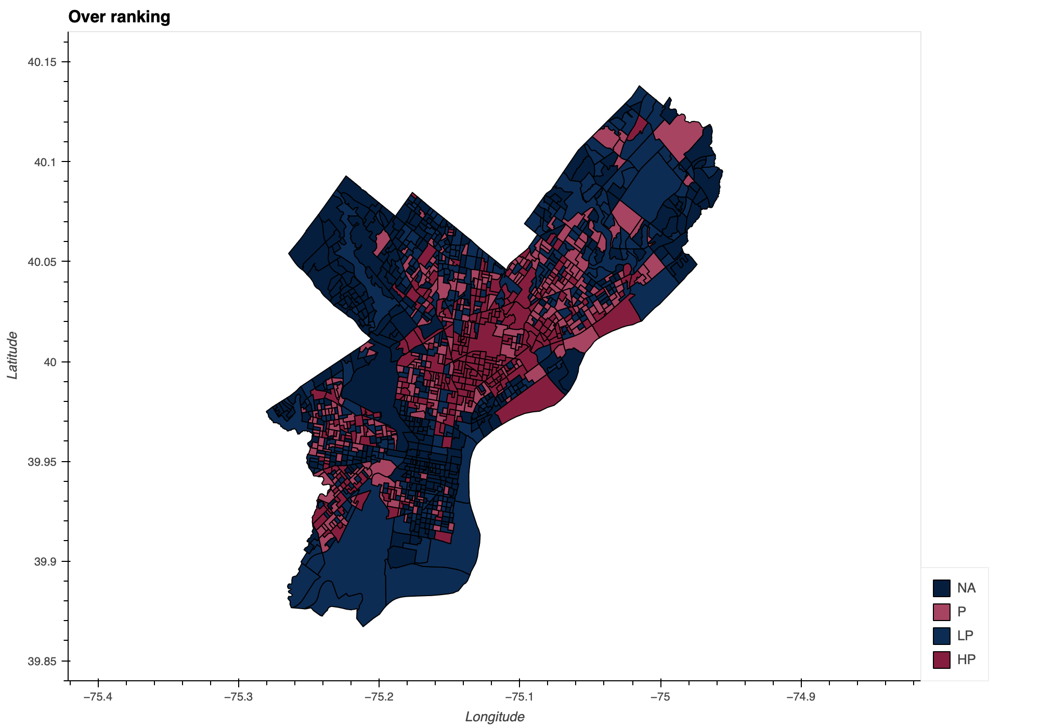
OVERALL RANKING OF THE POPULATION – BASED ON CENSUS

Slide 14
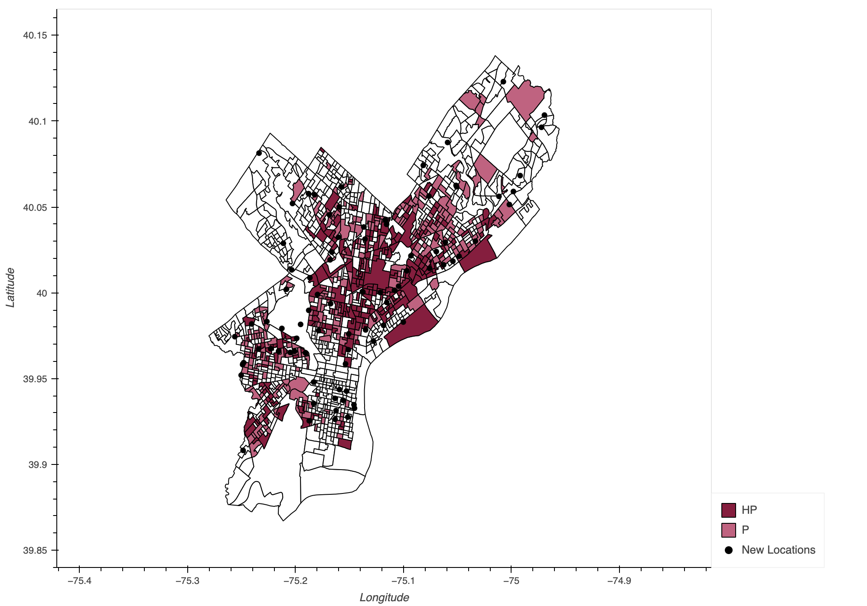
FINAL ANALYSIS
Tracts that are in high priority and priority bands with no meal sites or WI-FI locations
Locations of the sites where this network could be established to add on to the current meal sites.

Slide 15
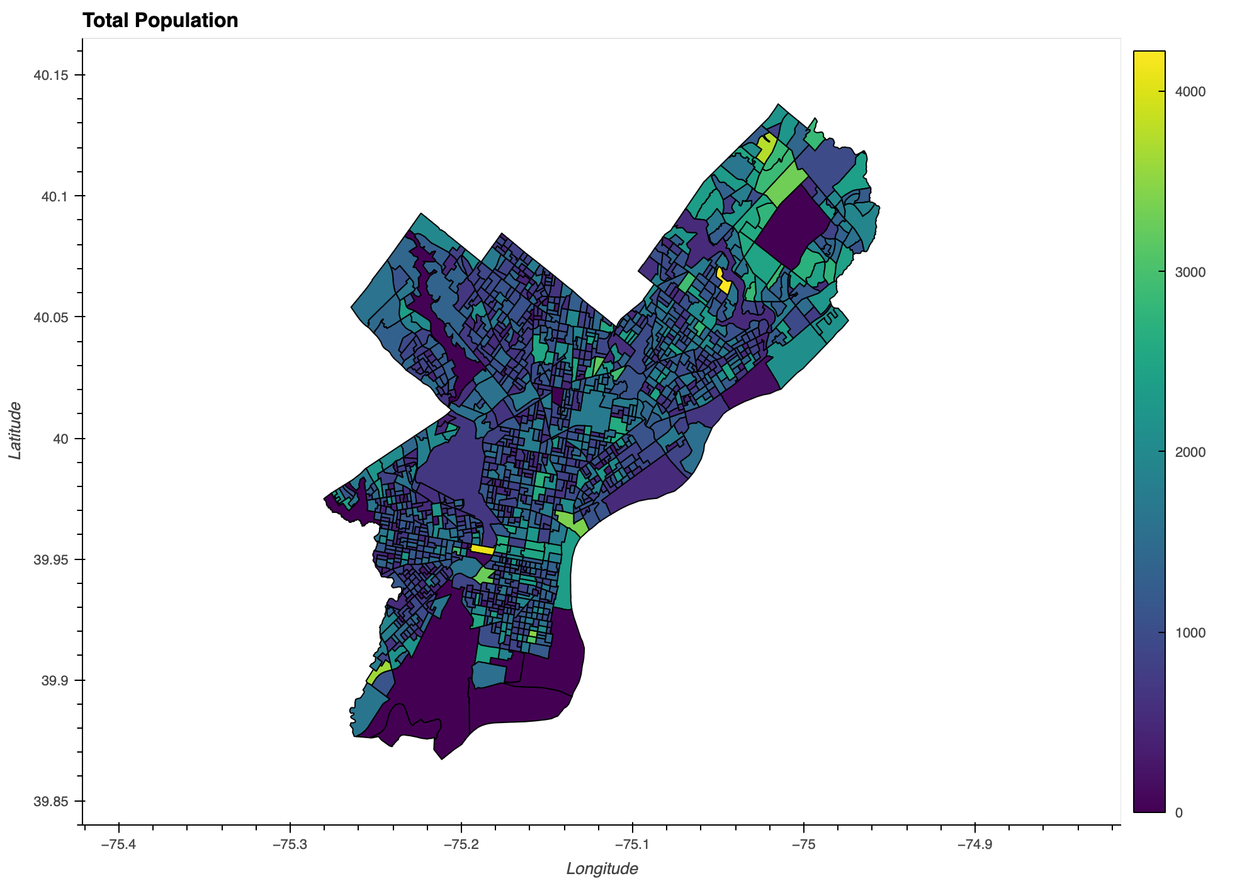
NEXT STEPS?
Analysing the total population and establishing the number of meal sites required per tract.
Quantitively accessing the food sources to the requirement.
THANK YOU
Notes:
Morning everyone!
I am Hasa, and I am here to my proposal for an initiative to tackle food insecurity while proving supporting infrastructure to further digital inclusively in the City of Philadelphia.

